Slide 1
TrueDepth Stroke Detection and Rehabilitation
Frank Pang
Computer Science, University of Southern California
Mentor: Matthew Sullivan
Notes:
Introduce myself (school, major, mentor)
In this room, raise your hand if a family member or someone you know has experienced or seen someone have a stroke.

Slide 2
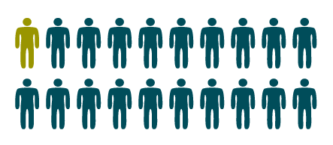
Problem: “Brain Attacks”
15,000,000
5,000,000
5,000,000
5th
Leading cause of death
795,000 610,000
140,000 185,000
240,000
1 in 20 deaths
Notes:
Why Do I Care?
Strokes are brain attacks, and lead to the death of 2 million brain cells every minute. It is the 5th leading cause of death in the US and is the number 1 killer in China
15 million people suffer stroke worldwide each year. Of these, 5 million die and another 5 million are permanently disabled.
Within the US, 795,000 have a stroke every year and of these people:
610,000 of them are having a stroke for the first time
140,000 of them will die, and 185,000 of them will have one again.
From these numbers, you can tell that strokes are a big issue – almost 1 in 20 people have one in the US
There’s even a chance that even one of us would get one
Within the time that I have been talking – roughly 40 seconds, someone in the US has had a stroke and may possibly be left permanently disabled if not dead. Stroke is a leading cause of serious long-term disability. Stroke reduces mobility in more than half of stroke survivors age 65 and over.
The window for applying drugs such as tPA is 4½ hours after the onset of a patient’s symptoms
“Mini-strokes” occur in approximately 240,000 people per year and indicate that a future stroke may occur

Slide 3
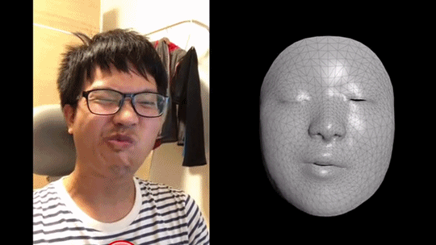
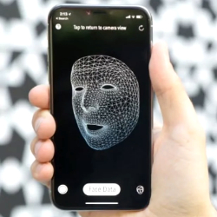
Solution:
Digitize FAST
Notes:
The Solution: iPhoneX TrueDepth scanning for Stroke Detection -> Rehabilitation
Our phones are always with us, no matter where we are.
We use them to communicate, plan, entertain, why not for health that tracks how our body is doing? One way is through facial scanning/monitoring EEG.
TrueDepth Camera in the iPhoneX allows for 3D scanning and accurate depth perception from just your phone
Scan your face, analyze your voice, and maybe even test your balance to indicate any symptoms
Track and analyze true metrics of your face, retaining a good idea of what your face should look like.
CDC recommends the FAST approach and we can digitize this simple process using an iPhoneX to track deviations in health issues
Sudden trouble with slurred speech, imbalance, blurred vision, understanding speech, and weakness of body (one side), face, etc are good indications of whether we’re having one.
You can have a stroke onset without you realizing
Warning signs of an ischemic stroke may be evident as early as seven days before an attack and require urgent treatment to prevent serious damage to the brain, according to a study of stroke patients.
Mini strokes/silent strokes
With diagnostics or specialized protocol, (EMS) providers fail 15% of the time. 40% without.
Post stroke effects on lifestyle
Detecting specifics of orofacial impairment post stroke

Slide 4
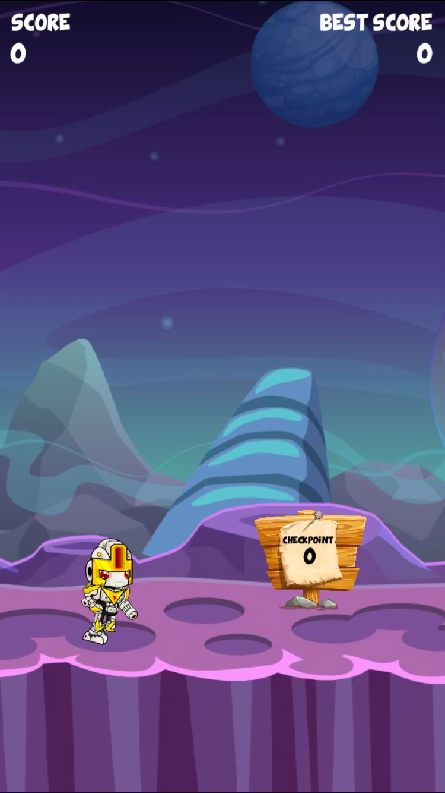

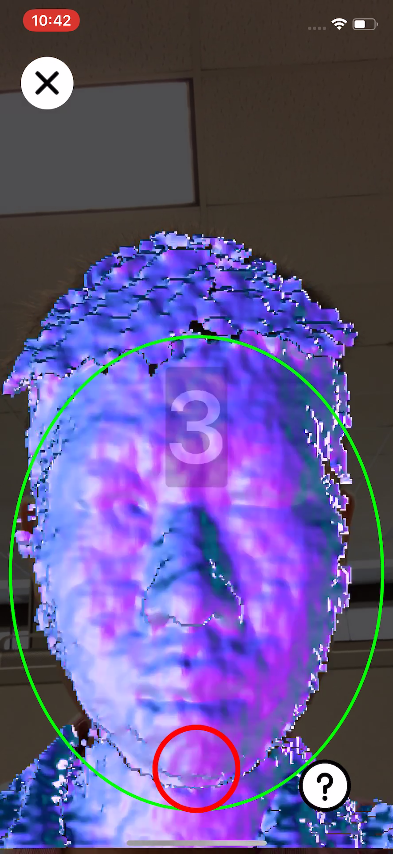
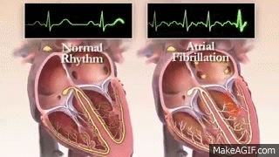
How It Works
1. Passively digitizing FAST
Face Scan
Balance Test
Voice Analysis
Coupled with Monitoring Heart Rhythms
2. Aiding recovery.
Voice/Facial feature activated games
Track user progress and recovery
Notes:
The Solution, the iPhoneX can
Detect mini strokes/strokes when they occur, in order to quickly make use of the 4.5 hour window stroke victims have
Rehabilitate victims of stroke by providing remote quality/consistent/objective care
There is a challenge in seeking and being provided quality/consistent care for individuals that can be solved with an iPhoneX app
Expensive and difficult to handle
Require an objective measure of what features are impaired.
Clinical practices are visually based and this fast pace leads to difficulty in monitoring recovery and rehab
A pleasant and easy user interface for ”Digitizing the FAST approach”
Active/Passive user tracking of face scans, voice, etc.
Users scan their face -> Analyze for face asymmetry, feature detection, and any signs of weakness
Users test their balance with a series of steps -> Accelerometer tracks motion and movement with feedback
Users speak tongue twisters/phrases -> Voice analysis and feedback
“Hey Siri, how does my voice sound?, The sky is blue or Peter piper picked a peck of pickled peppers”
Users are finally notified of any deviation in facial features, voice analysis, and typical heart beat activity.
If necessary, call EMS at the tap of a button.
Approximately one third of people who have a stroke develop aphasia: difficulties with language and communication that can include speaking, understanding, reading and writing.
- For patients and their loved ones, it can add another layer of frustration and anxiety to an already difficult situation.
However, high intensity speech therapy can help speed up recovery.
Speech Language Pathologists are not easily accessible. Therapy can be challenging, boring, and hard to stick with.
Individual, on-demand therapy can help fix that. Voice/Facial activated lessons that are curated by actual speech pathologists or facial therapy specialists can be used to improve speech and language performance and facial paralysis.
The platform would be a mobile application that provides a good user experience.
We bring our phones everywhere, it should also be an extension that monitors our health for our own benefit.

Slide 5
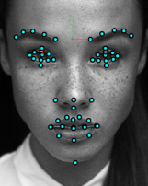
Market Analysis
Competitive Landscape
Costs United States $34 billion each year.
Save ~$30k/person
Licensing/Subscription
Stroke survivors,
Health organizations,
International interest
Free to scan
Mental/Facial Rehabilitation
Ease of Use
TrueDepth
Easy
Camera/Video
VIPS
Hard
Cost
High
Low
Notes:
Other Tech
Cerebrotech Medical Systems – VIPS
Meant for ambulance usage
92% accuracy; not common, not available for purchase
Camera/Video Analysis
Not commercialized
Lighting and depth issues lead to decreased accuracy
87/89% accuracy
No interface for recovery treatment
TrueDepth Camera
iPhones are popular
Apps can be easily updated to include certified speech/facial activated games
Depth cameras will be increasingly available
Get scanned with every unlock of your phone
Stroke costs the US a lot, and it can extend globally to countries like China
With the $34 billion estimate, and the 800,000 occurrences per year in the US, this amounts to approximately $30-40k savings depending on prevention and rehabilitation.
With purchases of $4.99 per subscription and 200,000 downloads a year, that’s $1,000,000/year from new users, rehab lasts for approximately two.
In addition, licensing can happen with therapists, speech pathologists, and hospitals
Summarize the following:
Of the 54 stroke survivors, 40 independent, 12 modified dependence, and 2 dependent at the time of discharge from inpatient rehabilitation.
Services and medications the first year post inpatient rehabilitation discharge was $17,081.
Cost of medication was $5,392
Yearly rehabilitation service utilization was $11,689.
Visual software for rehabilitation/detection of stroke in patients is definitely possible, as seen in competitors.
The goal is to make it increasingly accurate to avoid false alarms, and improve rehabilitation of stroke victims through 3D scanning and additional features.
In addition, current stroke detection victims available to the common user without being too intrusive/inconvenient in style/daily use.
If necessary to explain technologies:
Cerebrotech Medical Systems
Worn like a visor, picks up emergent large-vessel occlusion in patients with suspected stroke: with up to 92 percent accuracy.
A standard physical examination achieved between 40 to 89 percent accuracy in identifying patients with large-vessel occlusion, all of whom could benefit from endovascular therapy.
Volumetric impedance phase shift spectroscopy (VIPS) device
Works by sending low-energy radio waves through the brain, which change frequency when passing through fluids.
Waves are reflected back through the brain, and then detected by the device.
When a patient has a severe stroke, the brain’s fluids change, which produces an asymmetry in the radio waves detected by the VIPS device.
The greater the asymmetry, the more severe the stroke
Not a common-place item that can be easily accessible for individuals. No one wears such a bulky visor around
Depth Camera/Video Analysis
Video analysis uses facial landmarking and optic flow algorithms to detect facial weakness in videos.
Video analysis with optic flow can fall short when introduced with dynamic lighting. 3D capture with IR is a better approach
Depth camera research with Intel Real Sense and SDM algorithm for landmarking was done.
87% accuracy in detecting orofacial impairments in patients post stroke during speech/non-speech tasks.

